Slide 2
Paula Januszkiewicz
Adventures in the Underland:
Uncommon Hacker's Persistency Methods and Countermeasures

Slide 3



Adventures in the Underland:
Uncommon Hacker's Persistency Methods and Countermeasures
Paula Januszkiewicz
CQURE: CEO, Cybersecurity Expert
CQURE Academy: Trainer
Microsoft Regional Director
MVP: Cloud and Datacenter Management
www.cqureacademy.com
paula@cqure.us
@paulacqure
@CQUREAcademy

Slide 4

What does CQURE do?
Consulting Services:
Extensive IT Security Audits and Penetration Tests of all kinds,
Configuration Audit and Architecture,
Design Social Engineering Tests,
Advanced Troubleshooting and Debugging,
Emergency Response Services
R&D & CQLabs Tools & Hacks Publications
Trainings & Seminars:
Offline (mainly in New York or via our partners worldwide),
Online

Slide 5




Impactful Hacking Stats – 2021 Summary
316 days to locate and contain the breach, compared to the regular average of 287 days because of the remote work | 30% This is how much businesses could save up if they could contain a breach within 200 days | 20% Share of breaches initially caused by compromised credentials | 85% of breaches involved the human element
Source: Trend Micro, IBM, Verizon (2021)
Notes:
Organizations with more than 50% of their workforce working remotely took nearly 316 days

Slide 6
https://attack.mitre.org/tactics/TA0003/

Slide 7
Persistency Through Phishing

Slide 8
Persistency Through MFA Violation

Slide 9
Persistency Through Privileged Access or…

Slide 10


Classic Data Protection API
Based on the following components:
Password, data blob, entropy
Is not prone to password resets!
Protects from outsiders when being in offline access
Effectively protects users data
Stores the password history
You need to be able to get access to some of your passwords from the past
Conclusion: OS greatly helps us to protect secrets

Slide 11
Getting the: Classic DPAPI Secrets
DPAPI (classic)
A. MasterKey
1. pwdhash = MD4(password) or SHA1(password)
2. pwdhash_key = HMACSHA1(pwdhash, user_sid)
3. PBKDF2(…, pwdhash_key,…), another elements from the file. Windows 10 no domain: SHA512, AES-256, 8000 rounds
4. Control – HMACSHA512
B. CREDHIST
1. pwdhash = MD4(password) or SHA1(password)
2. pwdhash_key = HMACSHA1(pwdhash, user_sid)
3. PBKDF2(…, pwdhash_key,…), another elements from the file. Windows 10 no domain: SHA512, AES-256, 8000 rounds
4. Control – HMACSHA512
C. DPAPI blob Algorithms are written in the blob itself.

Slide 12
DPAPI + AD
CLIENT
AD SERVER
Local LSASS process (local masterkey can’t be decrypted)
RPC Call
BackupKey(masterkey)
LSASS process
Decrypted masterkey
G$BCKUPKEY_PREFERRED
DPAPI
Scenario: offline changed user password or local masterkey can’t be decrypted
G$BCKUPKEY_940db612-ee8f-4a31-84b3-8f80c25be855
CryptUnprotectData()
01 00 00 00 d0 8c 9d df 01 15 d1 11 8c 7a 00 c0
4f c2 97 eb 01 00 00 00 ......
DPAPI-PROTECTED BLOB

Slide 13
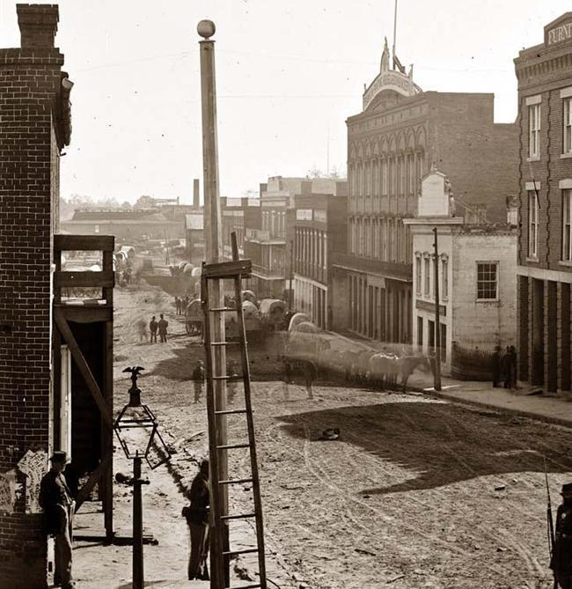
Cached Logons: It used to be like this…
Windows 2003 / XP
The encryption algorithm is RC4. The hash is used to verify authentication is calculated as follows:
DCC1 = MD4(MD4(Unicode(password)) . LowerUnicode(username)) is DCC1 = MD4(hashNTLM . LowerUnicode(username))
Usage in the attack
Before the attacks facilitated by pass-the-hash, we can only rejoice the "salting" by the username.
There are a number pre-computed tables for users as Administrator facilitating attacks on these hashes.
Notes:
https://commons.wikimedia.org/wiki/File%3AMarietta-Street-Atlanta.jpg

Slide 14
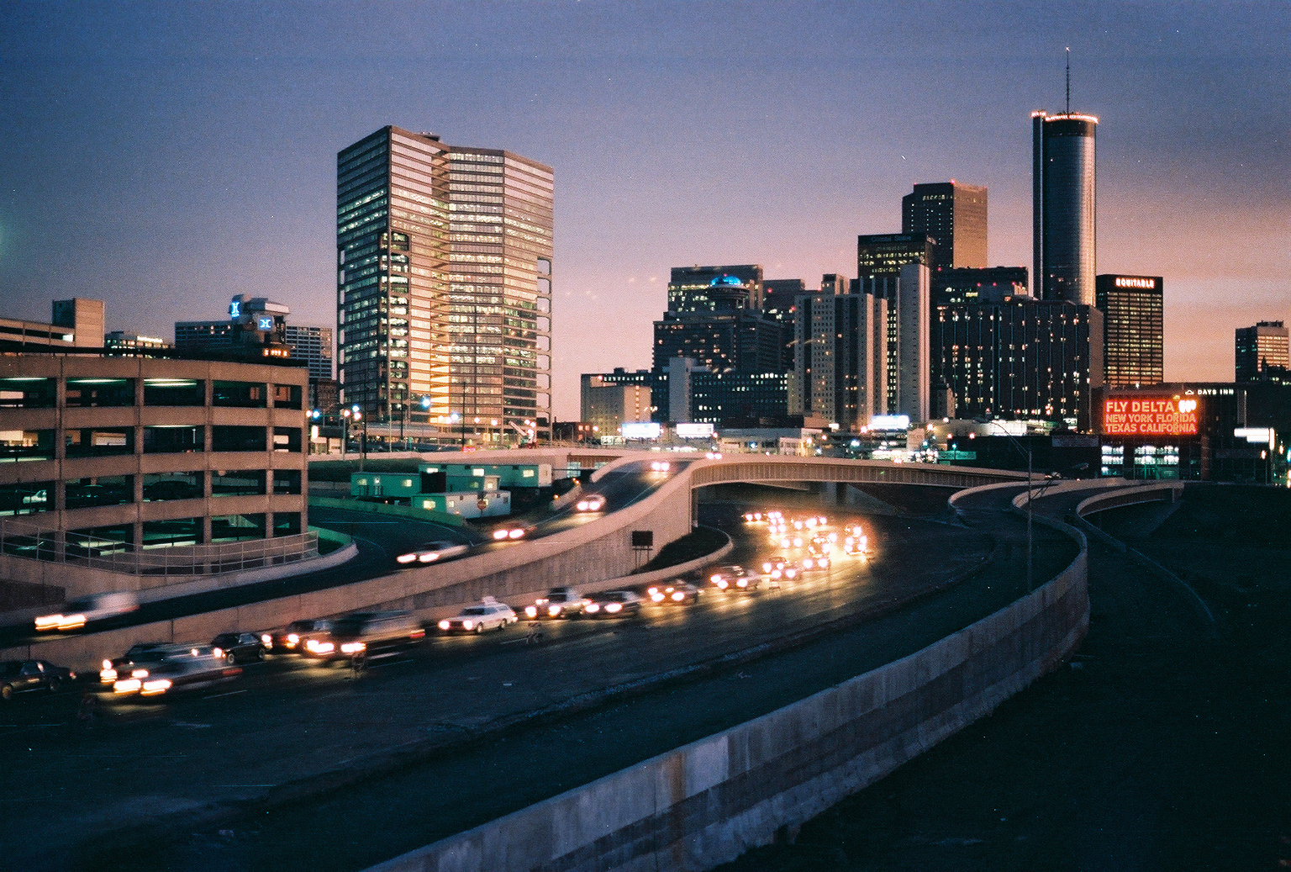
Cached Logons
Windows Vista / 2008 +
The encryption algorithm is AES128.
The hash is used to verify authentication is calculated as follows:
MSDCC2 = PBKDF2(HMAC-SHA1, Iterations, DCC1, LowerUnicode(username))
with DCC 1 calculated in the same way as for 2003 / XP.
There is actually not much of a difference with XP / 2003! No additional salting.
PBKDF2 introduced a new variable: the number of iterations SHA1 with the same salt as before (username).
Usage in the attack
Sysmon stores a hash base

Slide 15
Getting the: cached data
MSDCC2
bootkey: classes from HKLM\SYSTEM\CCS\Control\Lsa + [class names for: Data, GBG, JD, Skew1] (+arrays’ permutations) int[] permutationBootKey = new int[] { 0x8, 0x5, 0x4, 0x2, 0xb, 0x9, 0xd, 0x3, 0x0, 0x6, 0x1, 0xc, 0xe, 0xa, 0xf, 0x7 };
PolEKList: HKLM\SECURITY\Policy\PolEKList [default value]
lsakey: AES_DECRYPT(key, data) -> AES(bootkey, PolEKList)
NL$KM secret: HKLM\SECURITY\Policy\Secrets\NL$KM
nlkm_decrypted: AES_DECRYPT(lsakey, NL$KM secret)
Cache_Entry{id} -> HKLM\SECURITY\Cache\NL${id}
cache_entry_decrypted -> AES_DECRYPT(nlkm_decrypted, Cache_Entry{id})

Slide 16
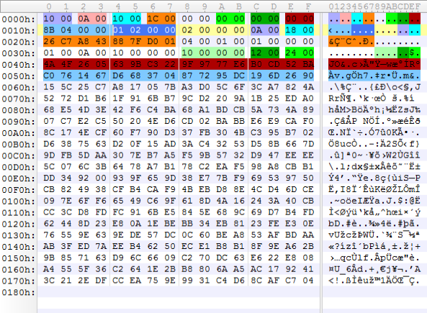
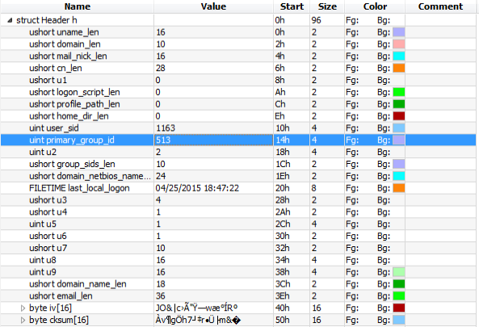
Encrypted Cached Credentials:
Legend
Encrypted Cached Credentials
DK = PBKDF2(PRF, Password, Salt, c, dkLen)
Microsoft’s implementation: MSDCC2=
PBKDF2(HMAC-SHA1, DCC1, username, 10240, 16)

Slide 17
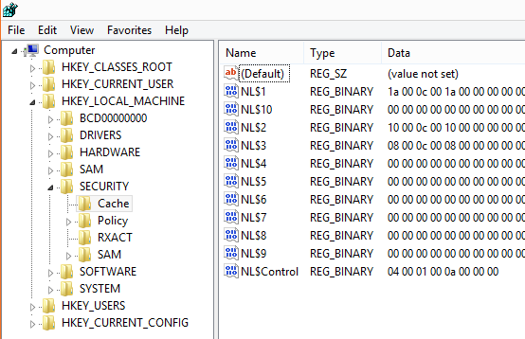
Cached Logons: Iterations
The number of iterations in PBKDF2, it is configurable through the registry:
HKEY_LOCAL_MACHINE\SECURITY\Cache DWORD (32) NL$IterationCount
If the number is less than 10240, it is a multiplier by 1024 (20 therefore gives 20480 iterations)
If the number is greater than 10240, it is the number of iterations (rounded to 1024)

Slide 18
Persistency Through Misconfiguration

Slide 19

Persistency Through Misconfiguration
Key learning points:
The best operators won't use a component until they know how it breaks.
Almost each solution has some ‘backdoor weakness’
Some antivirus solutions can be stopped by SDDL modification for their services
Configuration can be monitored by Desired State Configuration (DSC)
DSC if not configured properly will not be able to spot internal service configuration changes
Example: How do I get to the password management portal?

Slide 20
Persistency Through Default Settings

Slide 21

Persistency Through Old Defaults
Key learning points:
SNMPv3 addresses: user-based system for access control, a means to properly authenticate users, and a method for encrypting SNMP traffic between agent and host
SQL issues – TDS provides by default lack of encryption
ODBC Driver – check if it has a secure networking layer built into it

Slide 22
Demo: Clear Text Queries

Slide 23
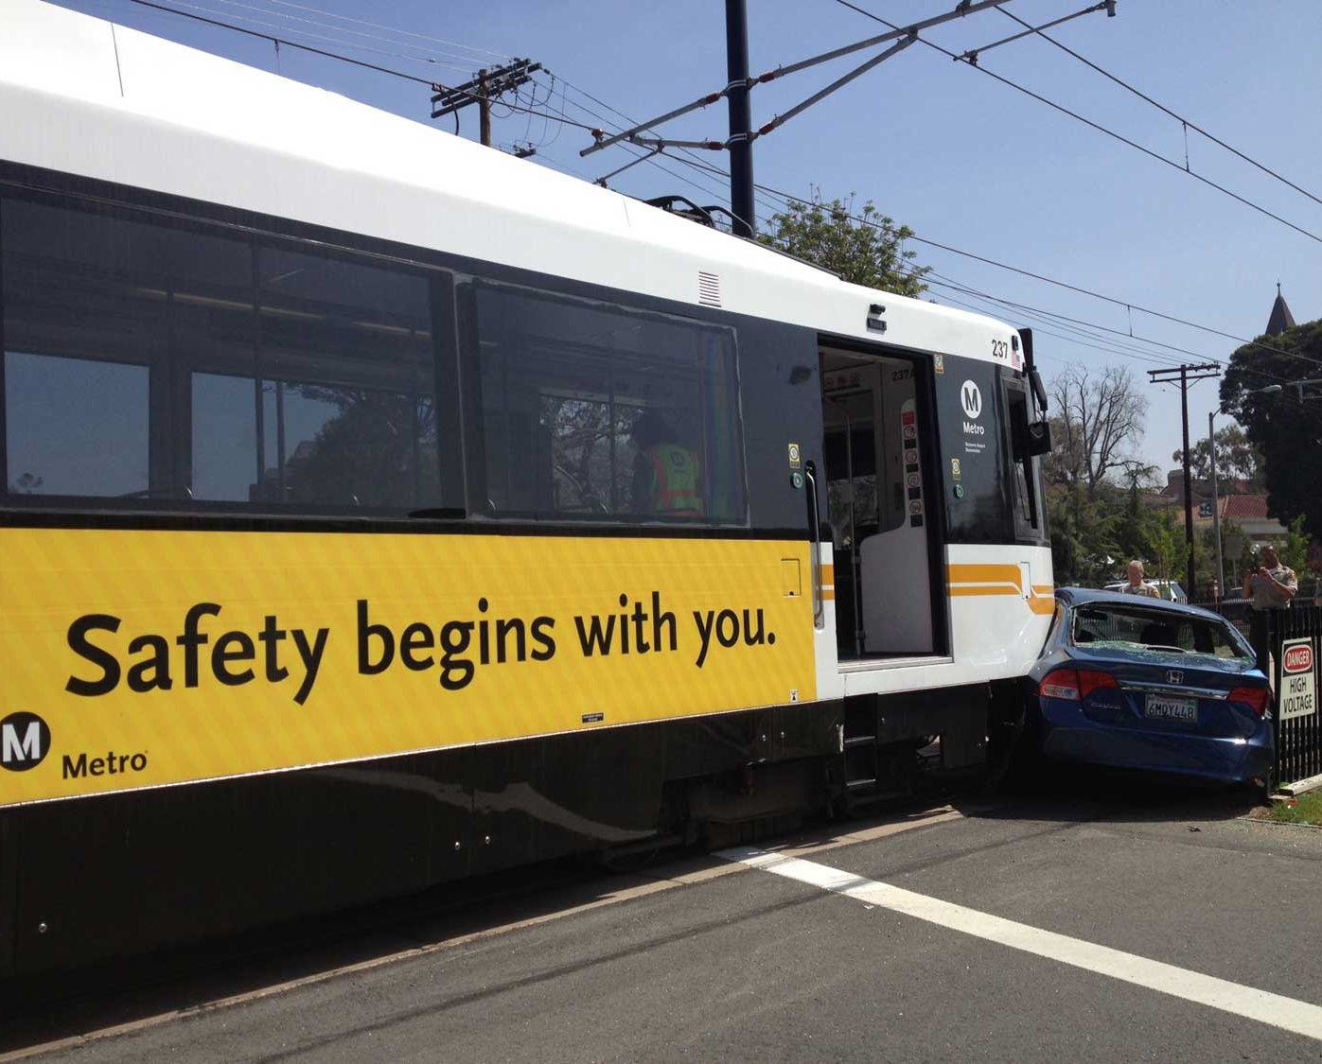
Persistency & Countermeasures: Summary
First and foremost, prevent unwanted programs from running.
Block file writes to unusual places, if possible, such as public user profile in Windows.
Reduce privileges so more advanced persistence techniques would fail due to missing privileges.
File system permissions should be checked regularly and be as restricted as possible.
Lock down configuration files (read-only) and put ACLs on specific registry keys.

Slide 24
Slides and demos from the conference will be available at
https://github.com/nordicinfrastructureconference/2022

Slide 25
THANK YOU!

